Slide 2


Slide 3

Christ In You -
The Hope Of Glory…
Col. 1:27
“Until Christ Is Formed In You…”
Gal. 4:19

Slide 4

The Spirit of Christ - In You…
2 Corinthians 6:16-7:1
Rom. 8:14
Do You Not Know?
1 Cor. 3:16-17
Eph. 2:11-22
Prov. 20:11
(19) Or do you not know that your body is a temple of the Holy Spirit who is in you, whom you have from God, and that you are not your own? (20) For you have been bought with a price: therefore glorify God in your body.
1 Corinthians 6:19-20

Slide 5

                (1) Therefore there is now no condemnation for those who are in Christ Jesus. (2) For the law of the Spirit of life in Christ Jesus has set you free from the law of sin and of death. (3) For what the Law could not do, weak as it was through the flesh, God did: sending His own Son in the likeness of sinful flesh and as an offering for sin, He condemned sin in the flesh, (4) so that the requirement of the Law might be fulfilled in us, who do not walk according to the flesh but according to the Spirit. (5) For those who are according to the flesh set their minds on the things of the flesh, but those who are according to the Spirit, the things of the Spirit. (6) For the mind set on the flesh is death, but the mind set on the Spirit is life and peace, (7) because the mind set on the flesh is hostile toward God; for it does not subject itself to the law of God, for it is not even able to do so, (8) and those who are in the flesh cannot please God. (9) However, you are not in the flesh but in the Spirit, if indeed the Spirit of God dwells in you. But if anyone does not have the Spirit of Christ, he does not belong to Him. (10) If Christ is in you, though the body is dead because of sin, yet the spirit is alive because of righteousness. (11) But if the Spirit of Him who raised Jesus from the dead dwells in you, He who raised Christ Jesus from the dead will also give life to your mortal bodies through His Spirit who dwells in you. (12) So then, brethren, we are under obligation, not to the flesh, to live according to the flesh— (13) for if you are living according to the flesh, you must die; but if by the Spirit you are putting to death the deeds of the body, you will live. (14) For all who are being led by the Spirit of God, these are sons of God.
Rom. 8:1-14

Slide 6
                (1) Therefore there is now no condemnation for those who are in Christ Jesus. (2) For the law of the Spirit of life in Christ Jesus has set you free from the law of sin and of death. (3) For what the Law could not do, weak as it was through the flesh, God did: sending His own Son in the likeness of sinful flesh and as an offering for sin, He condemned sin in the flesh, (4) so that the requirement of the Law might be fulfilled in us, who do not walk according to the flesh but according to the Spirit. (5) For those who are according to the flesh set their minds on the things of the flesh, but those who are according to the Spirit, the things of the Spirit. (6) For the mind set on the flesh is death, but the mind set on the Spirit is life and peace, (7) because the mind set on the flesh is hostile toward God; for it does not subject itself to the law of God, for it is not even able to do so, (8) and those who are in the flesh cannot please God. (9) However, you are not in the flesh but in the Spirit, if indeed the Spirit of God dwells in you. But if anyone does not have the Spirit of Christ, he does not belong to Him. (10) If Christ is in you, though the body is dead because of sin, yet the spirit is alive because of righteousness. (11) But if the Spirit of Him who raised Jesus from the dead dwells in you, He who raised Christ Jesus from the dead will also give life to your mortal bodies through His Spirit who dwells in you. (12) So then, brethren, we are under obligation, not to the flesh, to live according to the flesh— (13) for if you are living according to the flesh, you must die; but if by the Spirit you are putting to death the deeds of the body, you will live. (14) For all who are being led by the Spirit of God, these are sons of God.
                But if anyone does not have
                the Spirit of Christ,
                he does not belong to Him.
Rev. 2:5
Does Not Have God…
2 John 1:9
Serious???
Rom. 8:1-14

Slide 7
(22) But the fruit of the Spirit is love, joy, peace, patience, kindness, goodness, faithfulness, (23) gentleness, self-control; against such things there is no law. (24) Now those who belong to Christ Jesus have crucified the flesh with its passions and desires. (25) If we live by the Spirit, let us also walk by the Spirit.
Gal. 5:22-25

Slide 8

The Spirit of Christ In You…
What Does It Not Look Like?
Rom. 2:24-29
Gal. 5:16-26
1 Cor. 3:1-3
Js. 3:1-12; 13-18

Slide 9
The Spirit of Christ In You…
What Does It Look Like?
1 Tim. 2:8 Men Lifting Up Holy Hands
Prove The Spirits To See…
1 John 4:1ff Three Tests…
2 Cor. 8:1-5 Gave Self First
1 Cor. 8-10 Not Self-Willed
Heb. 12:5ff Men Leading Homes
Prov. 31:10-31 Women Leading In Homes
1 John 4:10-12 Loving My Brethren…
Acts 8:26-40 Ethiopian

Slide 10

God Is Reaching Out…
Am I Reaching Back and Responding To The Will Of God?

Slide 11

The Word Of God
Is Tried and True…
So What Will I/We Do???

Slide 12
“For We Are The True Circumcision, Who Worship In The Spirit Of God And Glory In Christ Jesus And Put No Confidence In The Flesh,”
Phil. 3:3

Slide 13
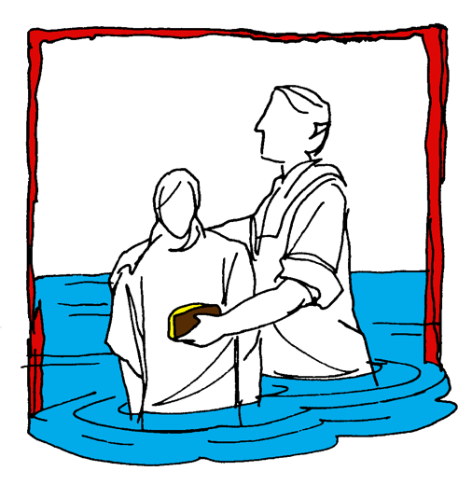


Hear (Rom. 10:17)
Believe (Jn. 8:24)
Repent (Acts 2:38)
Confess (Mt. 10:32-33)
Baptism (Acts 22:16)
Mk. 16:
15-16
Continue… (Matt. 28:20)
Committed To Follow Jesus

